Slide 1
Employee Retention

Slide 2
01
Problem Statement
Data Overview
02
TABLE OF CONTENTS
04
Model & Evaluation
EDA & Feature Engineering
03
05
Business Implication
Conclusion
06

Slide 3
01
INTRODUCTION

Slide 4
Problem Statement
Three objectives:
Understand the headcount for different companies with respect to time
Find out main factors from the data that drive employee churn, and explain
Suggest potential factors to investigate

Slide 5
02
Data Overview

Slide 6
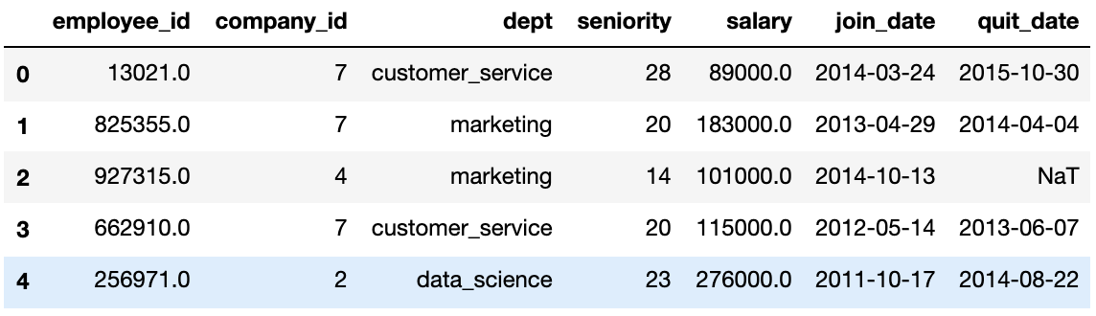
Variable Explanation
Employee ID: unique identifier for each employee
Company ID: unique identifier for each company, 12 companies in total
Department: 6 different departments
Seniority: years of working experience before joining the company
Salary: average yearly salary
Join Date
Quit Date

Slide 7
03
EDA & Feature Engineering

Slide 8
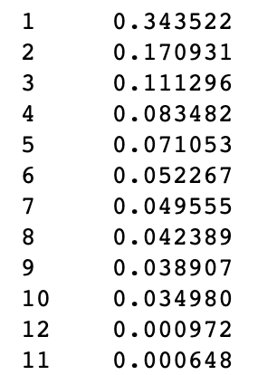
Data Wrangling
Missing Value
7 columns in total, only quit date contains missing value
Generate a new variable “churn” from “quit_date”, and use as the target variable in later use
Outlier Analysis
Seniority: 98 & 99 → must be wrong entries
Company ID: company 11 and 12 have really low presence in the dataset and might influence the performance of the machine learning model. Won’t use for machine learning, but would leave as it is to understand the headcounts in different companies.

Slide 9
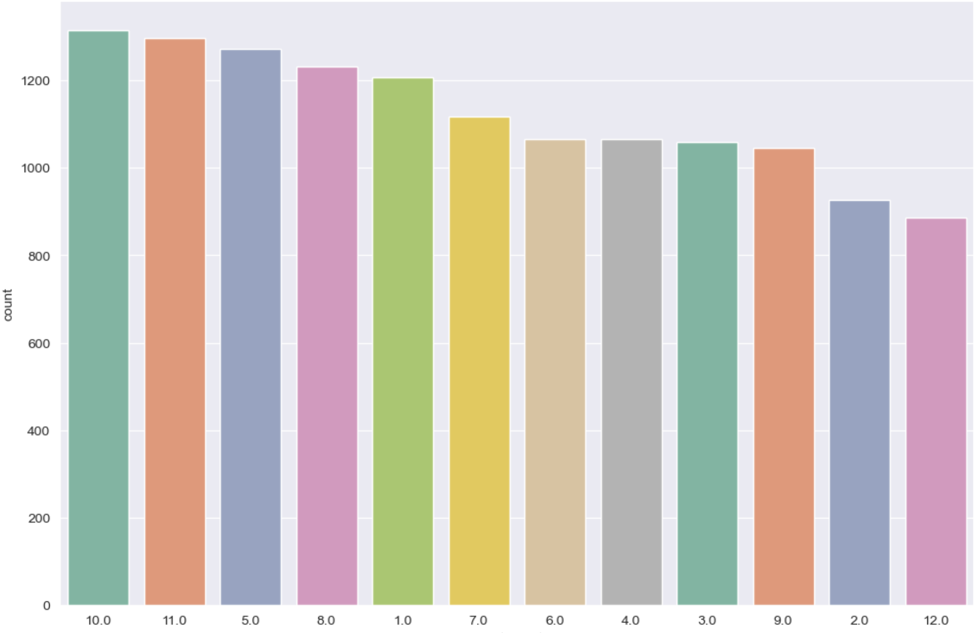
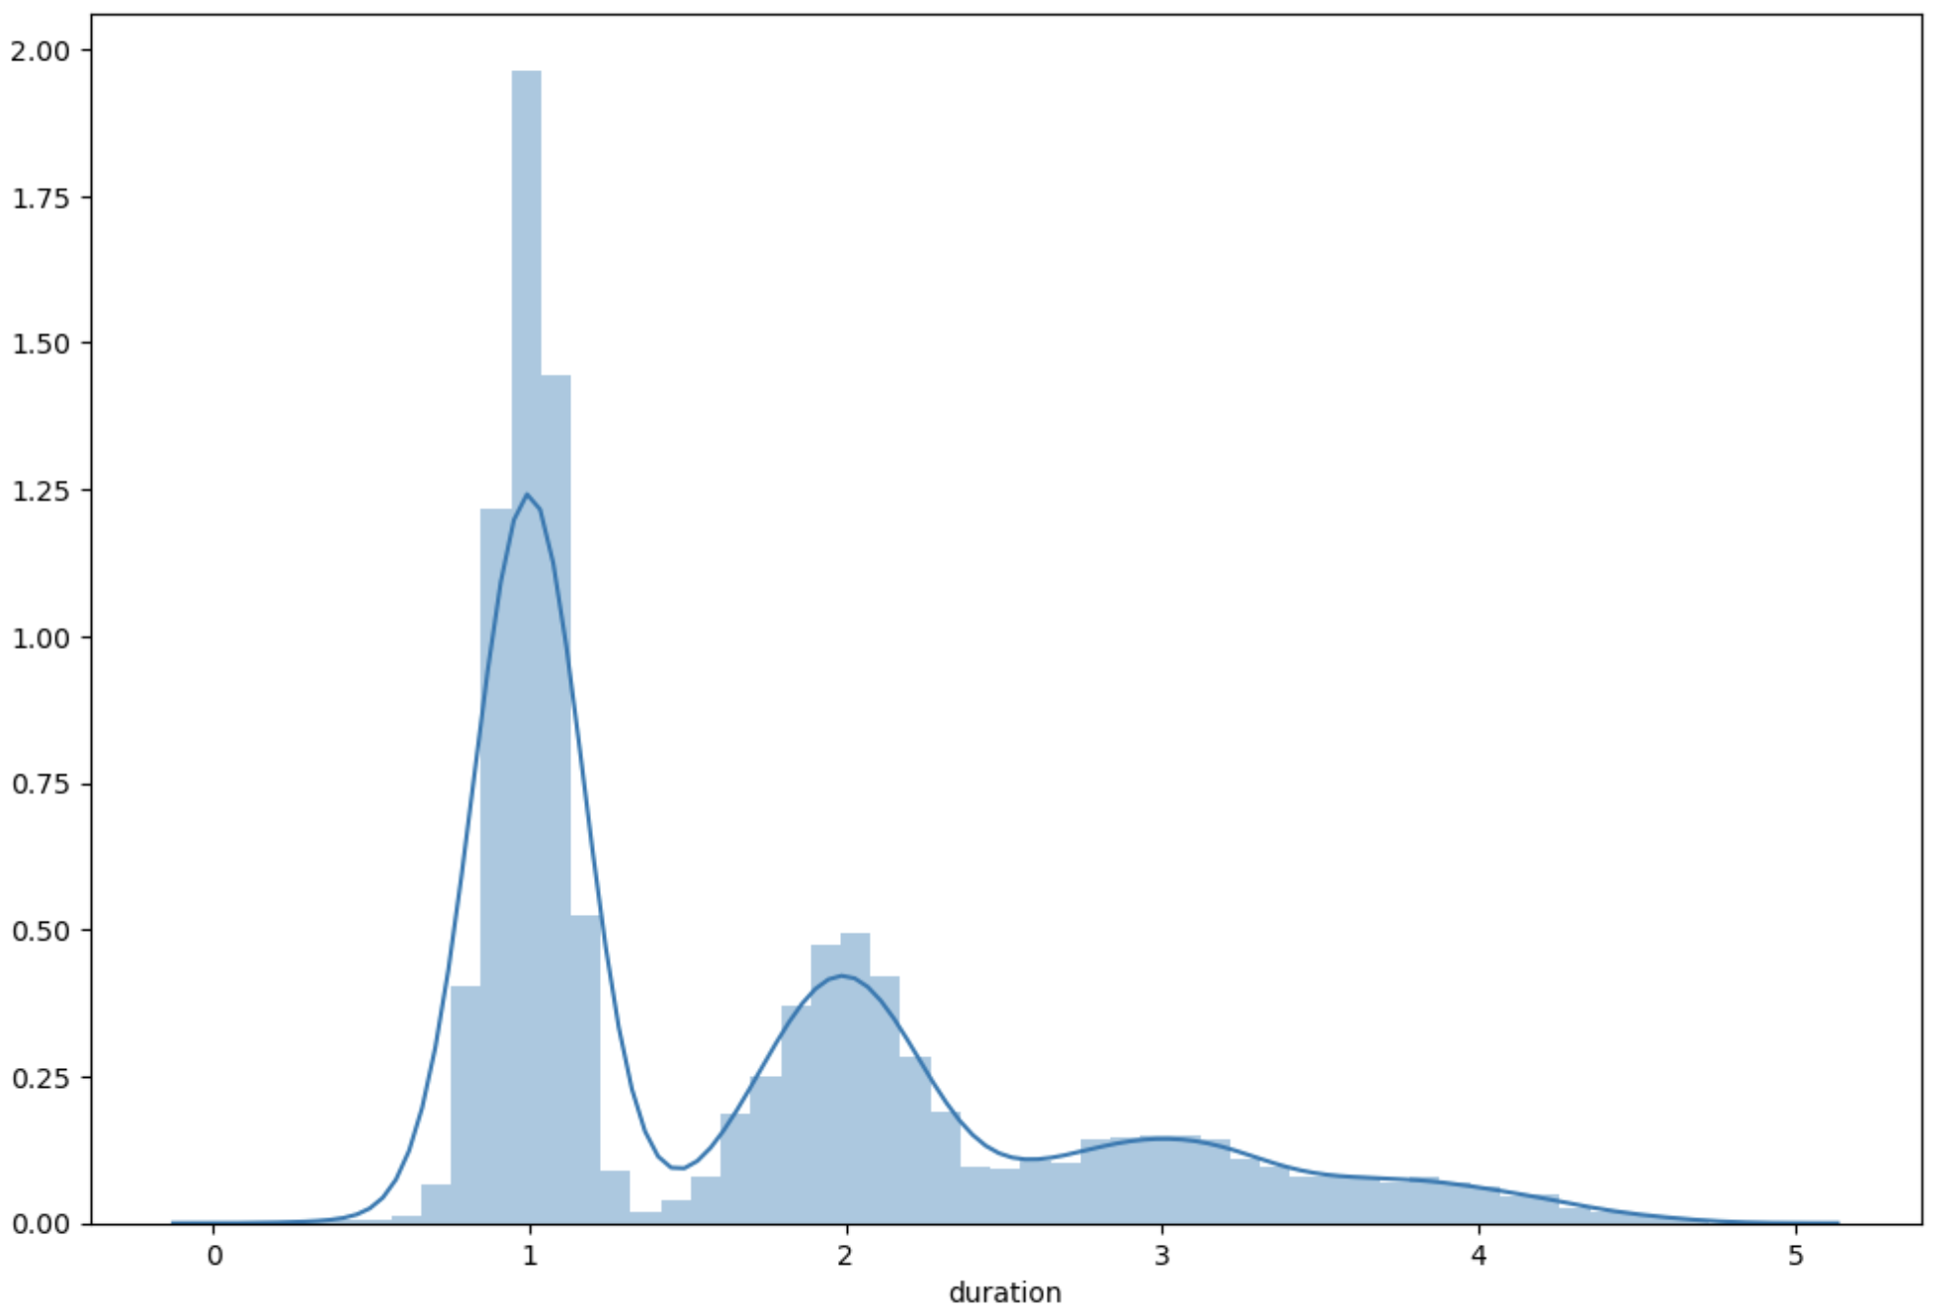
EDA & Feature Engineering: time
3 new variables: Join Month / Quit Month / Duration
Highest retention in Oct & lowest in Dec.
Employees who join the company for 1 year are more likely to quit

Slide 10
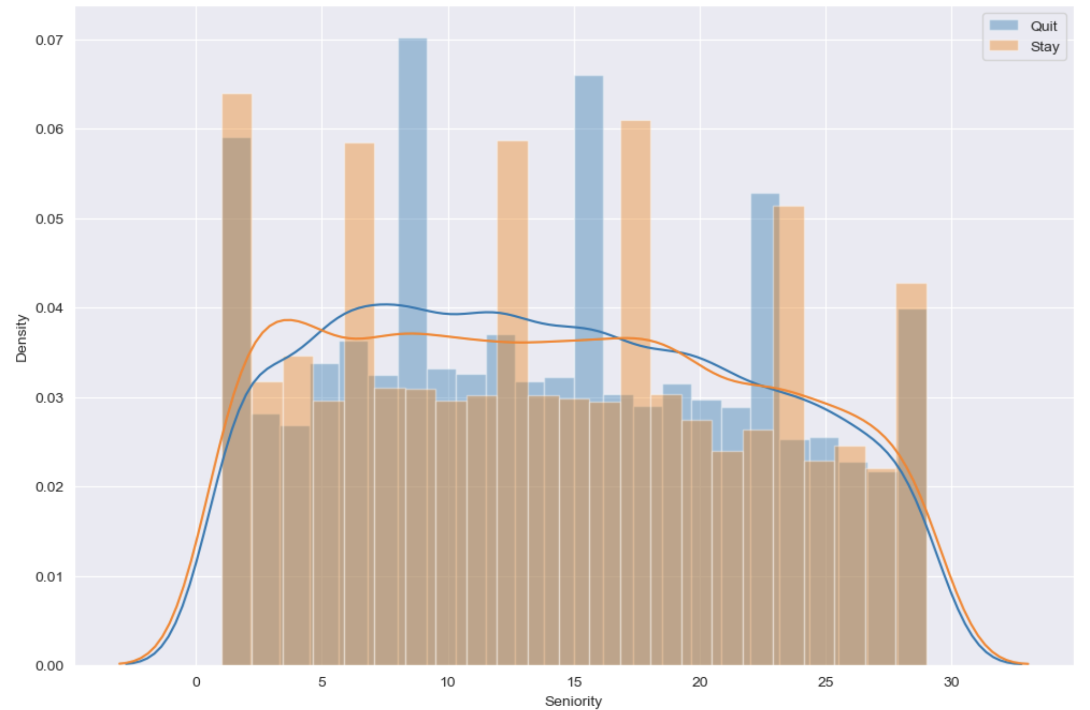
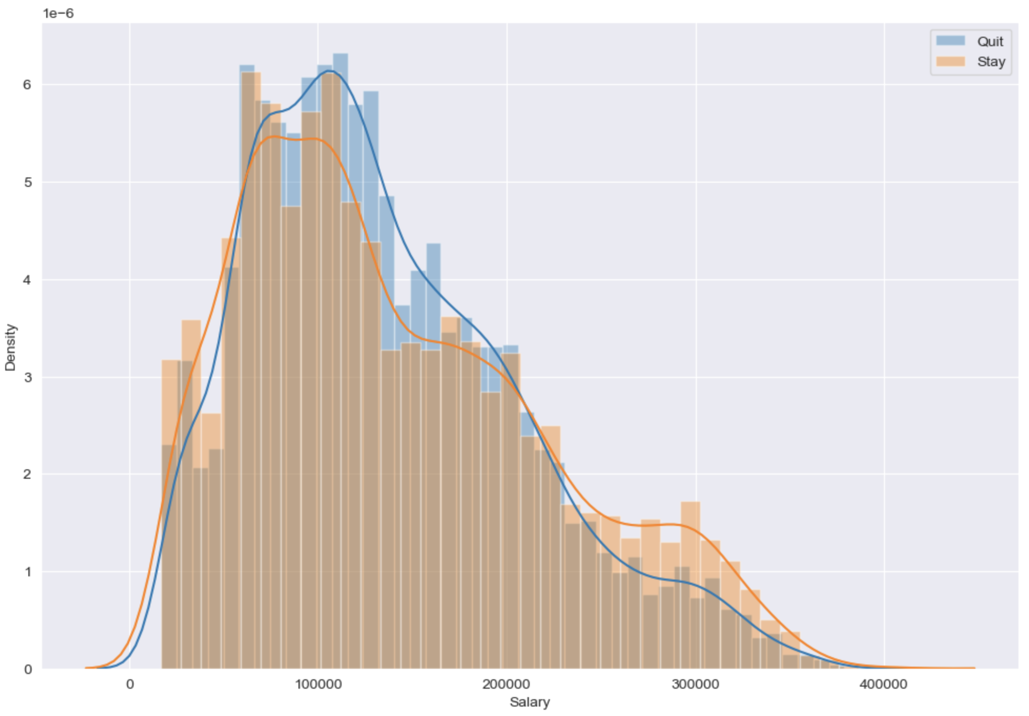
EDA & Feature Engineering: Seniority & Salary
Generate new column: Salary/seniority → pay_ratio
Shows similar trend, but there’s difference of the peak
Employees with Mid-Lower salary have higher potential of quit

Slide 11
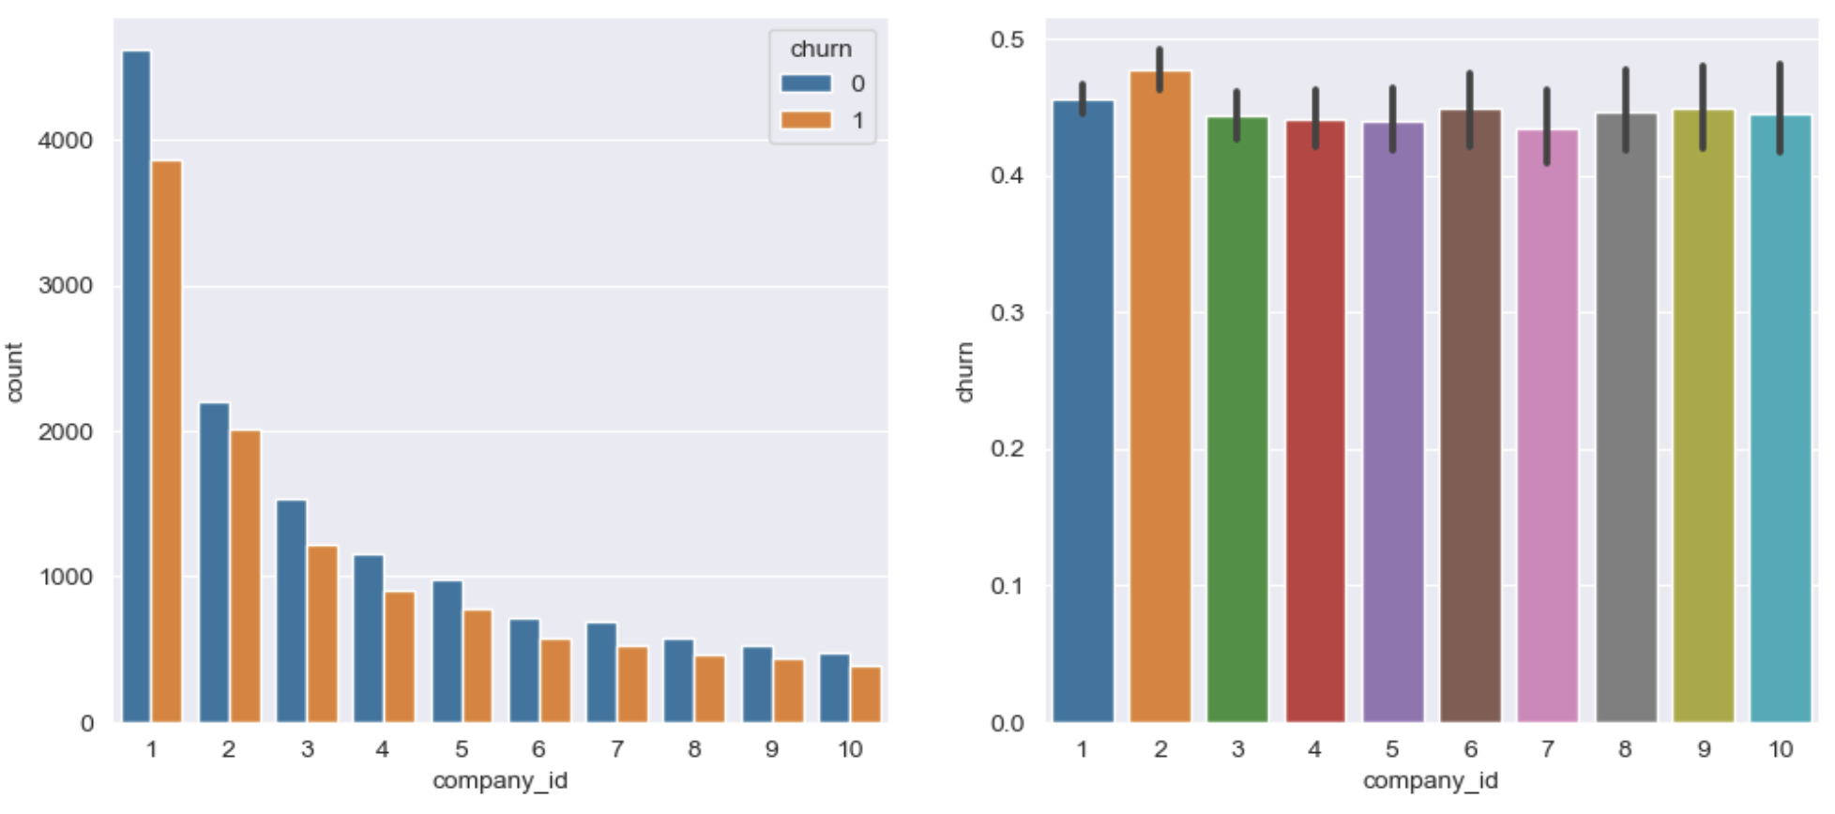
EDA & Feature Engineering: Company & Department

Slide 12
04
Model & Evaluation

Slide 13
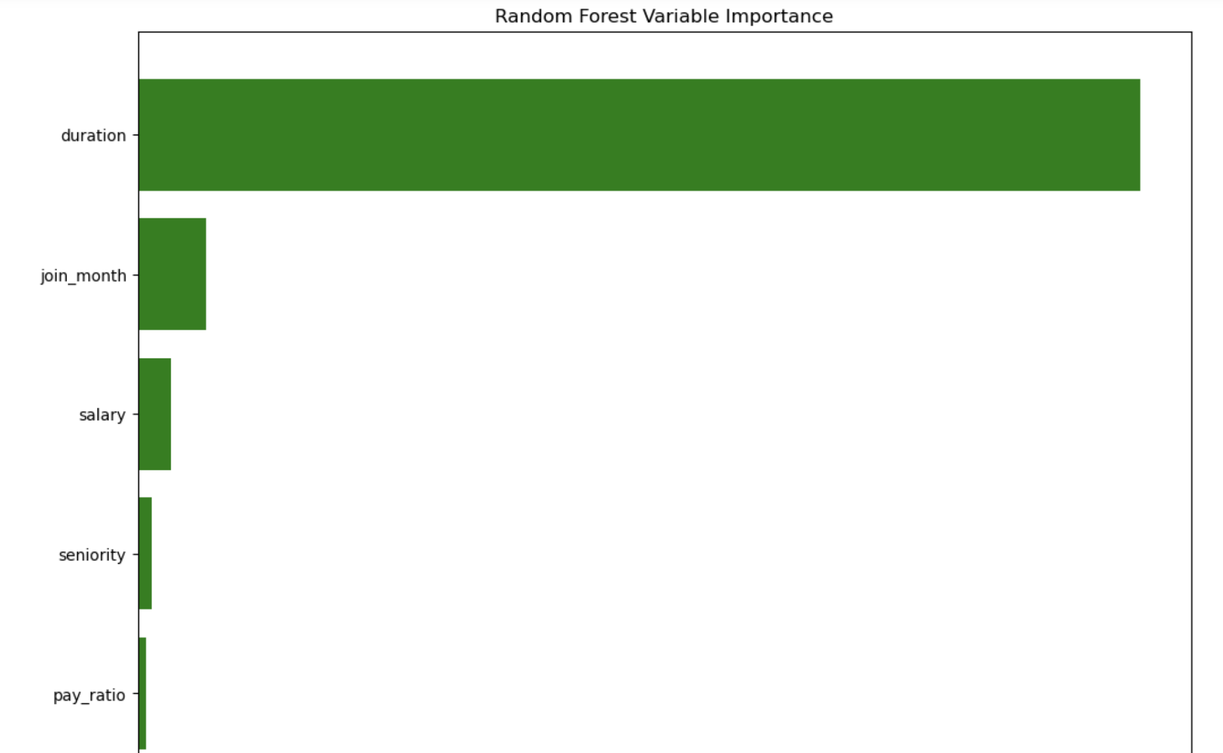
Model: H2ORandomForest
Variables used for the model:
Company ID
Department
Seniority
Salary
Join Month
Salary – Seniority Ratio
Duration

Slide 14
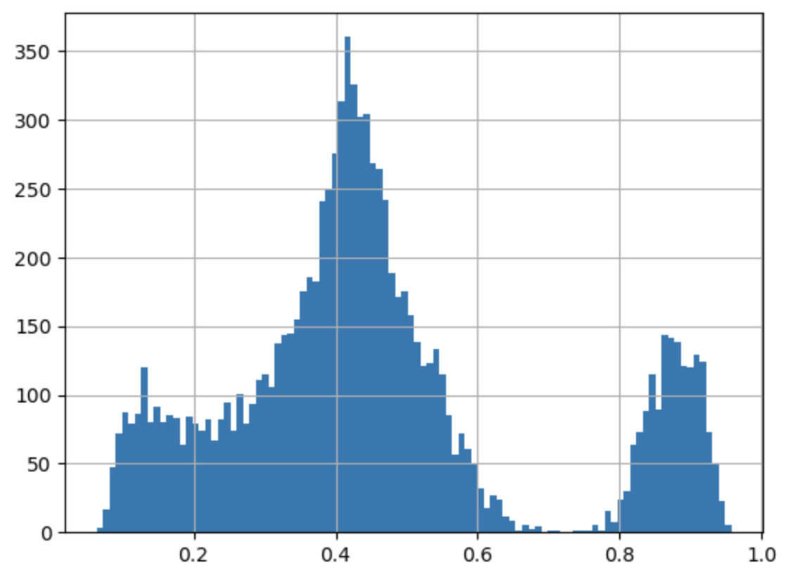
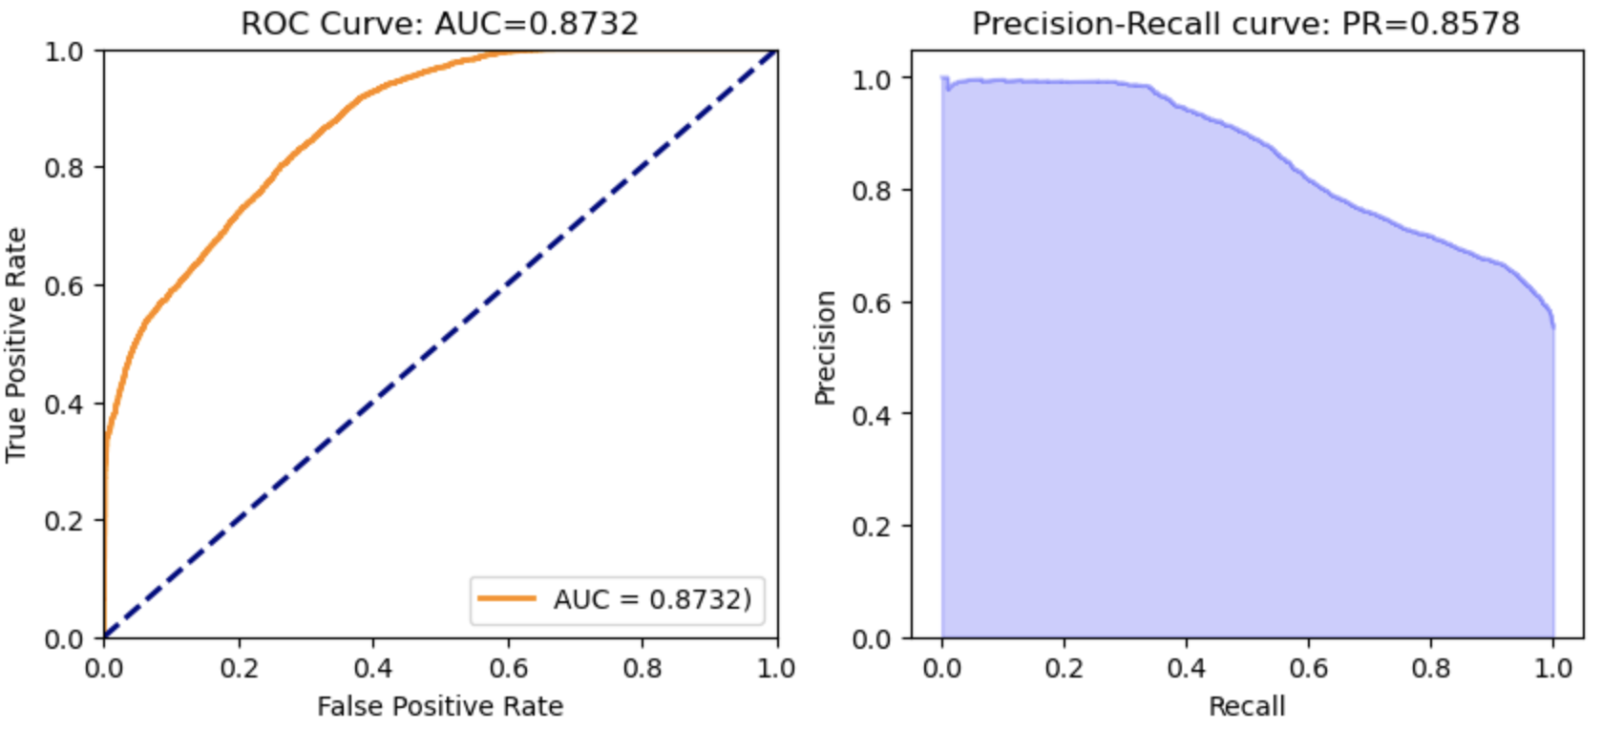
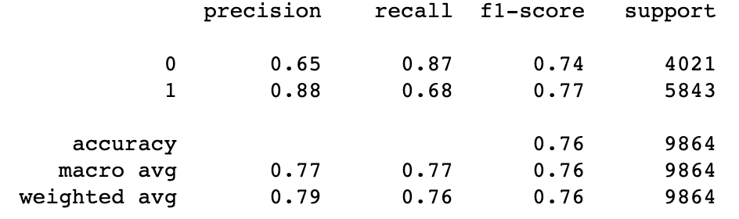
Model: Evaluation
Threshold of 0.2:
Prediction >= 0.4 → quit
Prediction < 0.4 → stay

Slide 15
05
Business Implication

Slide 16
Other Factors
Work-Life-Balance
Work schedule flexibility
Teammate relationship/group work satisfaction: how happy is the employee with the team
Health/wellness benefits
Tail-Performer layoff
Top performer recognition and rewards
Personal Development
Compensation
Management & Leadership Team
Onboarding & TrainingGradient Boosting Model

Slide 17
06
Conclusion

Slide 21

Data Preparation
Two datasets
Large datasets - each customer id has a lot of records (per month or per half month)
Group by Masked_id
Extract the year from “from date” (2014-2019)
Create new pivot tables
Calculate each customer’s average electricity consumption(kWh) by year
Calculate each customer’s average electric bill amount($) by year
Calculate each customer’s electric bill amount multiples based on the belonged town’s average
Small dataset - general information & annualized data
Merge datasets
277,919 participants
Proportion of program participate between Yes and No: 1:9
Balanced for models

Slide 22
System Monitoring
Capacity of the system
CPU
GPU
Memory Usage
Network I/O
Notes:
CPU
GPU
Memory Usage
Network I/O

Slide 23
Data Preparation
Clean Data
Drop columns
Unimportant variables
Over 99% are 0
E.g, 2014_AVG_EL_CONSUMP, 2015_AVG_EL_CONSUMP, 2014_AVG_BILL_CONSUMP, 2015_AVG_BILL_CONSUMP,
AVG_2014_BILL_MULTIPLES, AVG_2015_BILL_MULTIPLES
Highly correlated variables
E.g, Zip Code vs. Town, Longitude, Latitude
ELSC vs. Customer Segment,
ANNUALIZED_KWH vs. ANNULIZED_DMD
Data transformation
ELSC: electric service class → category type
Program part: ‘Y’ for 1; ‘N’ for 0
Turn on date → number of days since they joined ConEd
ZIP → take first 4 digits and transfer into category

Slide 24
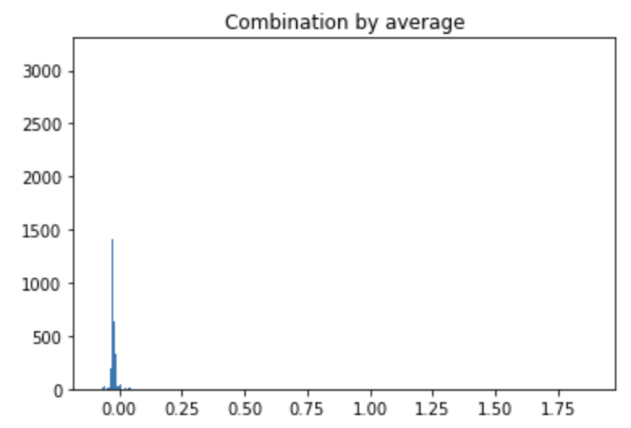
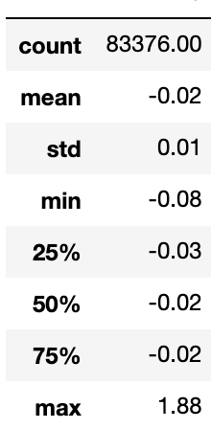
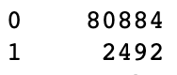
Outlier Analysis
KNN model - aggregation method:
Standardize data
20 models, number of clusters ranges from 10 to 200
Take the average anomaly scores for all models
Normalize test score
Cutting threshold: 0
2% anomaly records

Slide 25
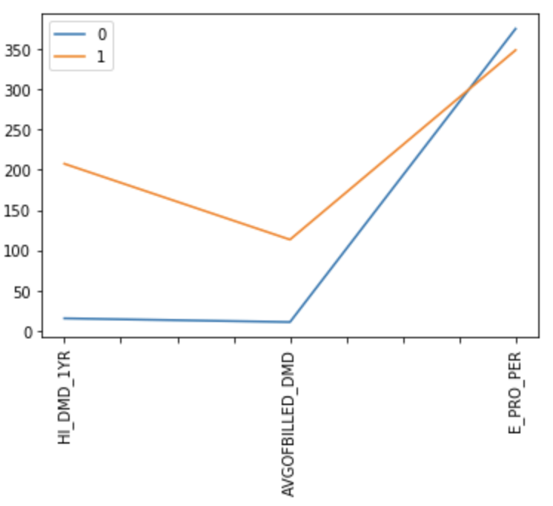
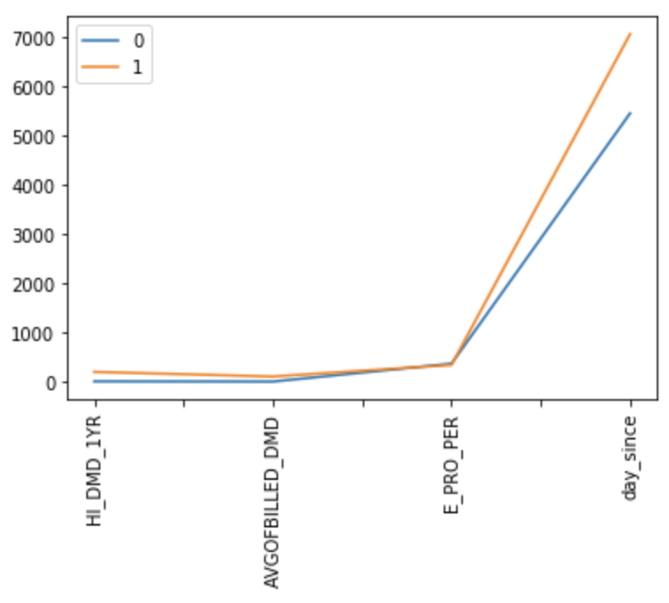
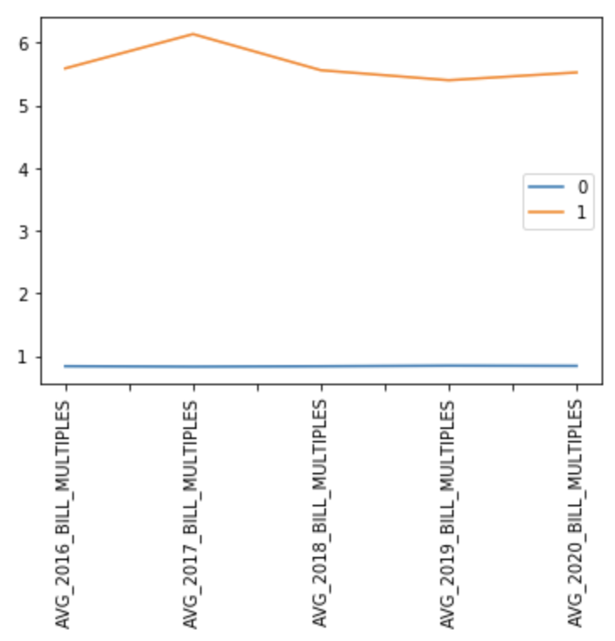
Outlier Analysis

Slide 26
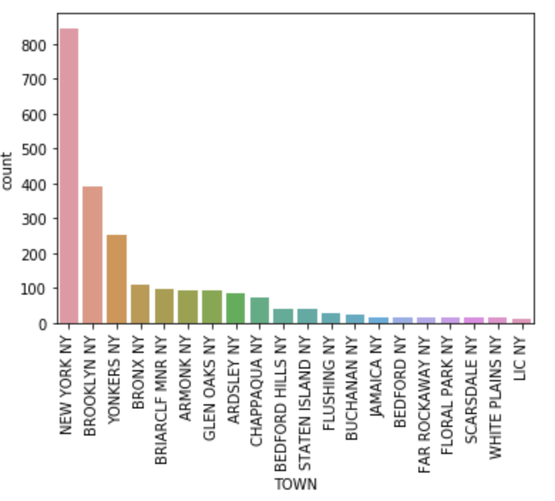
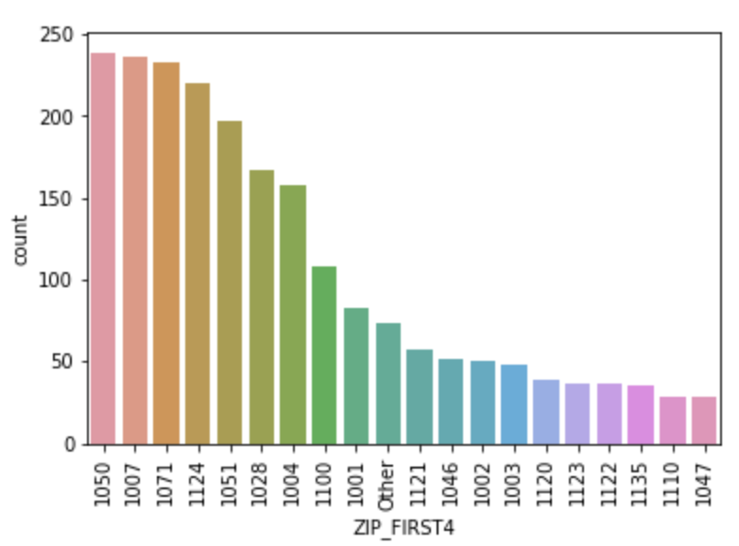
Outlier Analysis - Geography

Slide 27
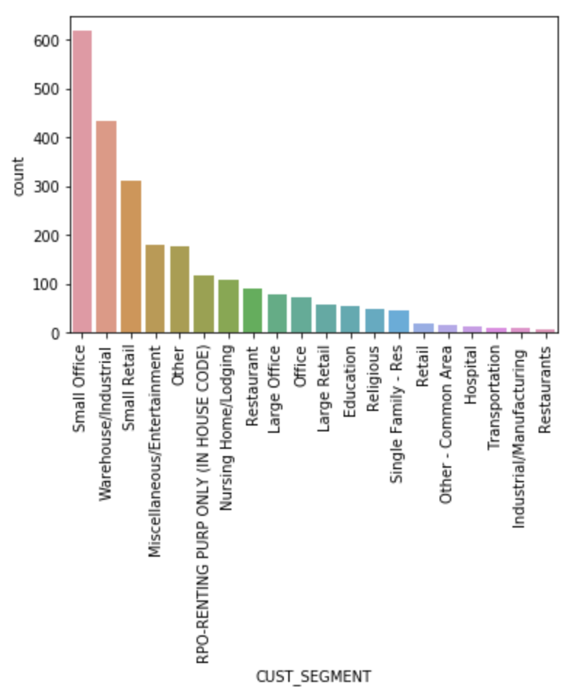
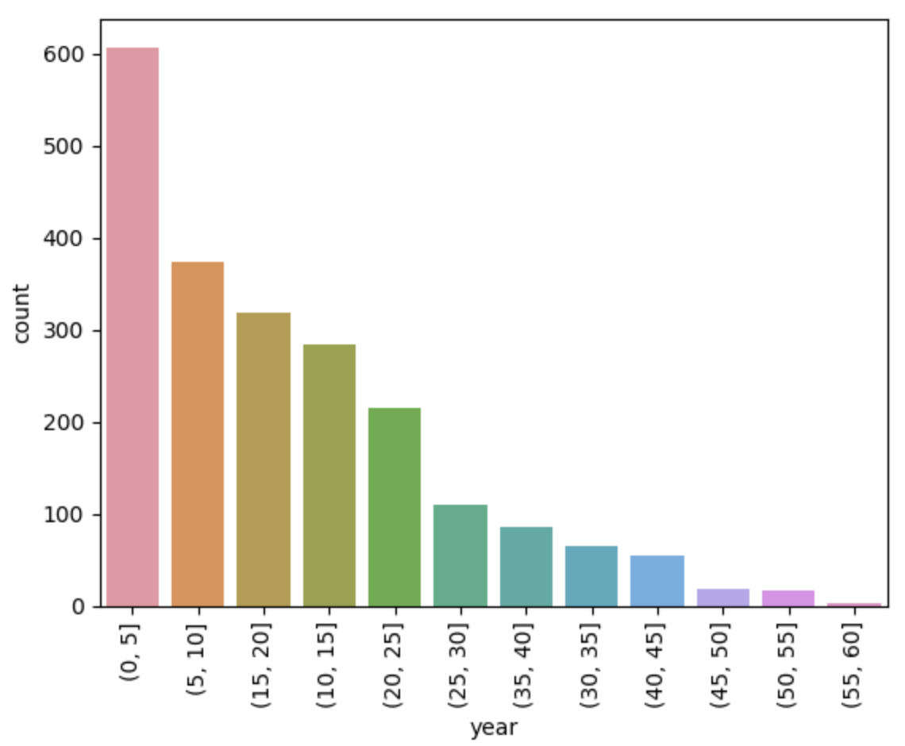
Outlier Analysis - Customer Segment & Years Joined

Slide 28
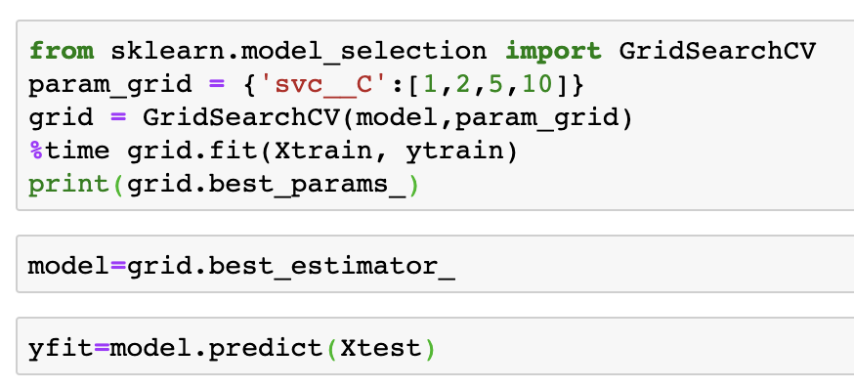
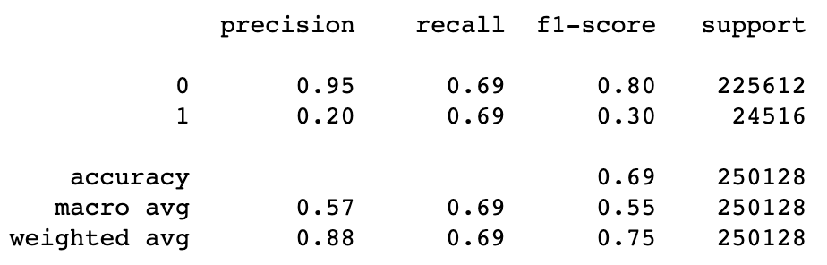
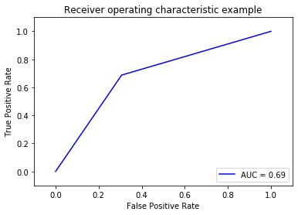
Model 1 - SVM
Effective to solve high dimensional and non-linear classification problem
Outstanding generalization ability
Kernel: RBF
Features: 139
Penalty Factor: C = 10 (Cross Validation)

Slide 29
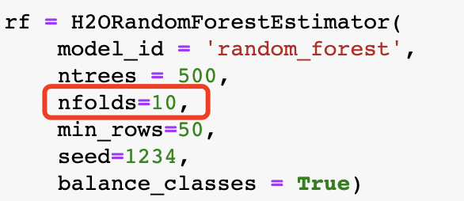
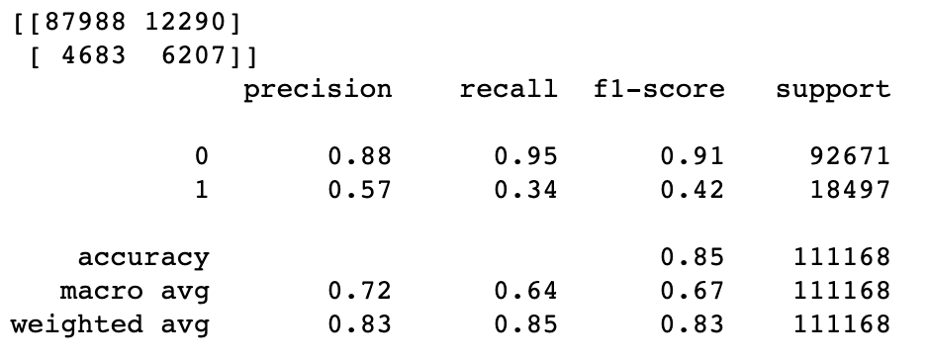
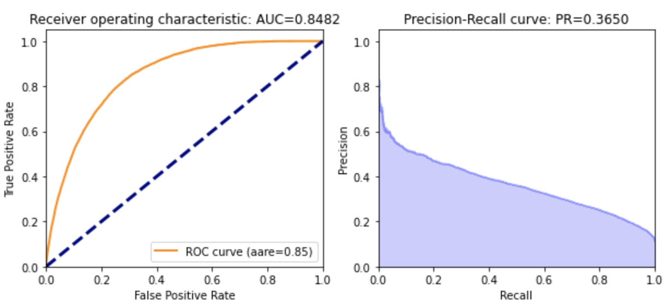
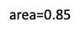
Model 2 - Random Forest
What we care: Higher F1-Score for the Minority Group (those who update → 1)
Threshold of 0.2:
Prediction >= 0.2 → “Yes” (1)
Prediction < 0.2 → “No” (0)
10-folds cross validation
Automatically encoding

Slide 30
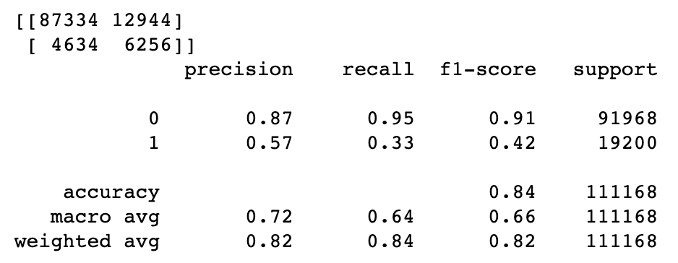
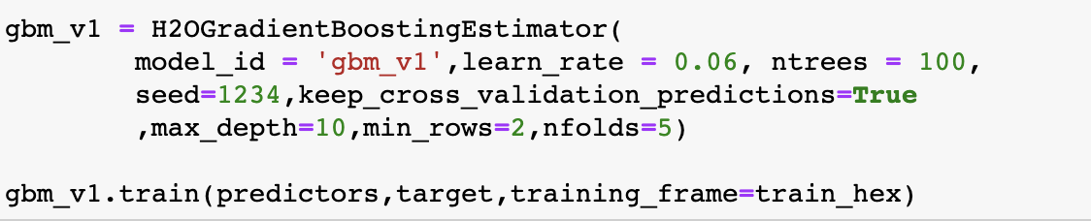
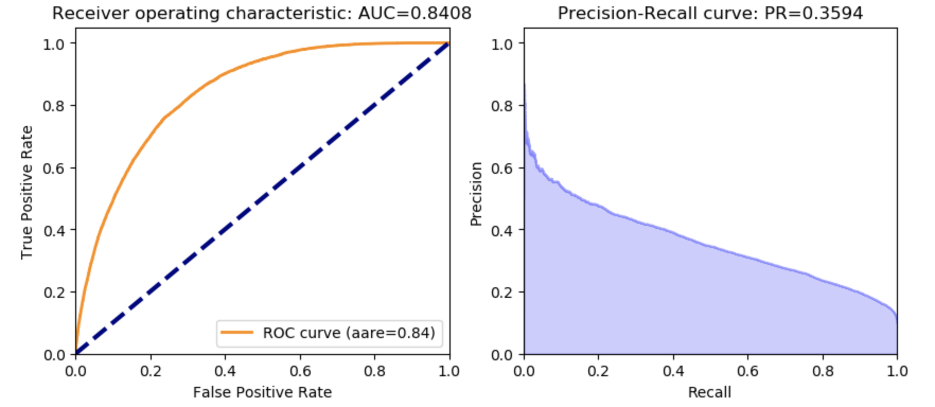
Model 3 - Gradient Boosting
Model parameter tuning is important
Threshold of 0.25:
Prediction >= 0.25 → “Yes” (1)
Prediction < 0.25 → “No” (0)
5-fold cross validation > 10-fold cross validation

Slide 31
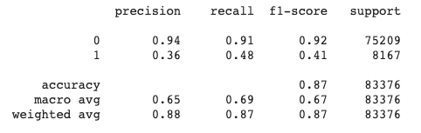
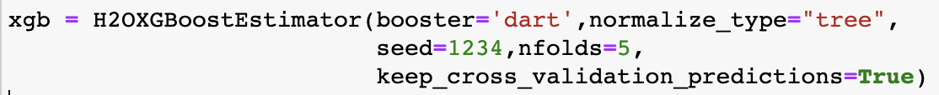
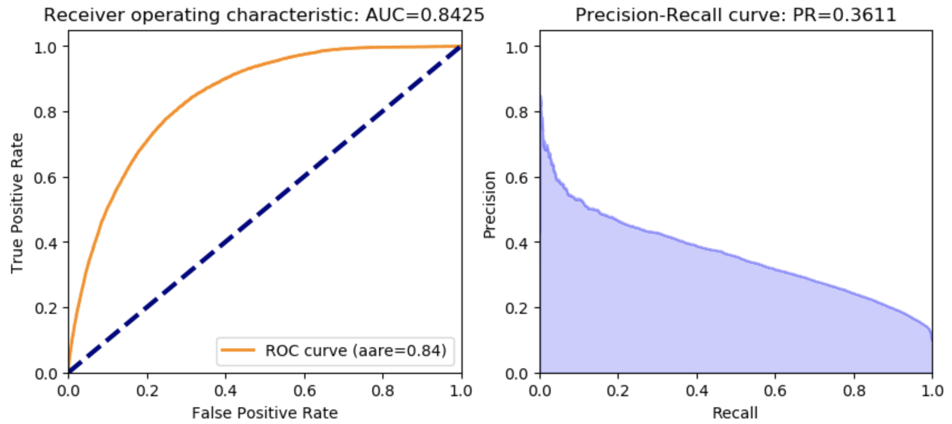
Model 4 - XGBoost
Fast: Parallel Computing
Built-in cross-validation
Robust to outliers and overfitting
(regularization)
Change prediction from classification (e.g. 0/1) to probability (e.g. 0.78)
Threshold of 0.25:
Prediction >= 0.25 → “Yes” (1)
Prediction < 0.25 → “No” (0)

Slide 32
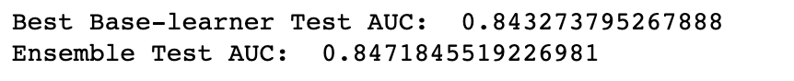
Model 5 - Stacked Model
Used models: Random Forest, Gradient Boosting, XGBoosting

Slide 33
Model recommendation
Model Name | GBM | XGBoost | Random Forest | SVM | Stacking model
Run Time (s) | 71.5 | 115.8 | 596.1 | 1059 | 813.8
Performance - ROC AUC | 84.08% | 84.25% | 84.82% | 69% | 84.71%
Performance - Precision Recall AUC | 35.94% | 35.11% | 36.50%
Performance - F1 | 0.82 | 0.87 | 0.83 | 0.81 | 0.83
Performance - Minority F1 | 0.42 | 0.41 | 0.42 | 0.3 | 0.42
Final selection: Gradient Boosting Model

Slide 34
Model recommendation
Model Name | GBM | XGBoost | Random Forest | SVM | Stacking model
Run Time (s) | 71.5 | 115.8 | 596.1 | 1059 | 813.8
Performance - ROC AUC | 84.08% | 84.25% | 84.82% | 69% | 84.71%
Performance - Precision Recall AUC | 35.94% | 35.11% | 36.50%
Performance - F1 | 0.82 | 0.87 | 0.83 | 0.81 | 0.83
Performance - Minority F1 | 0.42 | 0.41 | 0.42 | 0.3 | 0.42
Final selection: Gradient Boosting Model

Slide 35
04
ANALYTICAL APPROACH

Slide 36
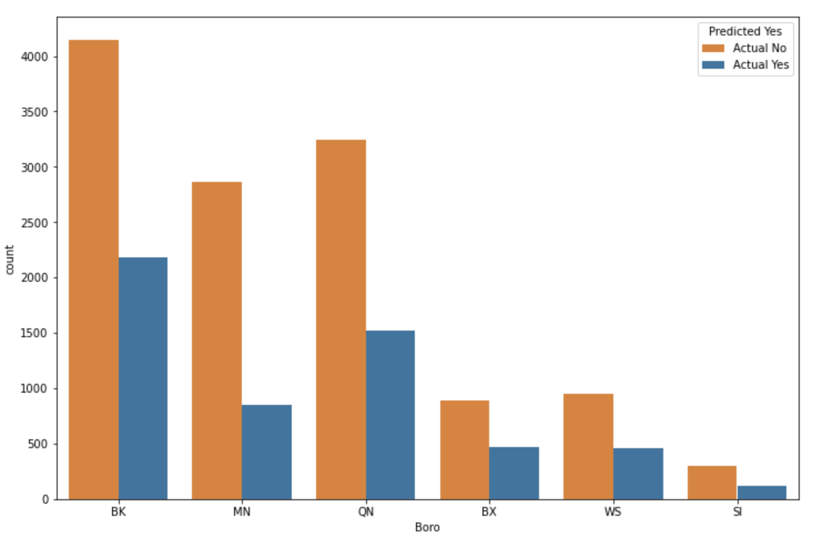
Business interpretation - Borough
Model Predict “Yes”, Actual “NO”:
Customers should join EE program, but they have not.
Targeted Boro: BK, QN, MN, WS

Slide 37
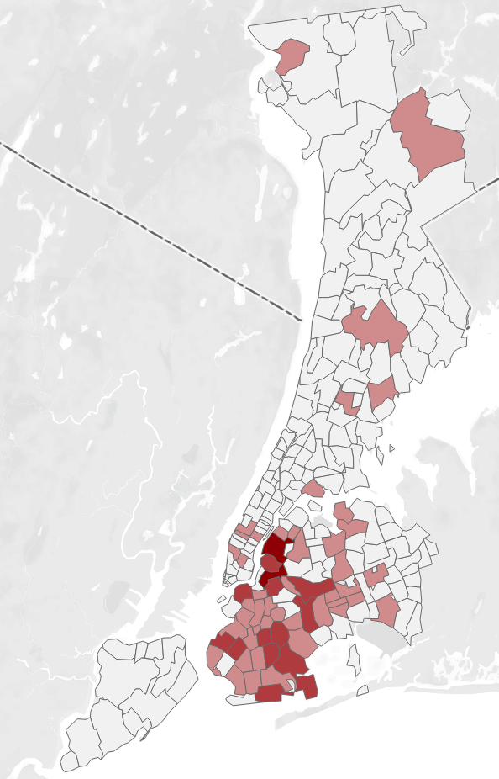
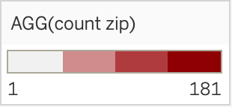
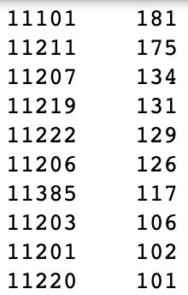
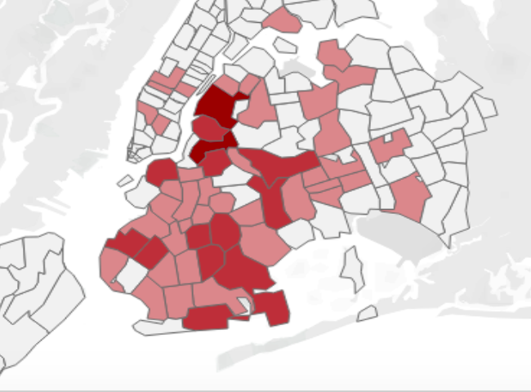
Business interpretation - Zip code
Actual: No; Predict: Yes
Brooklyn area: Kings County, Williamsburg
Queens area: LIC, Ridgewood
Zip code Count

Slide 38
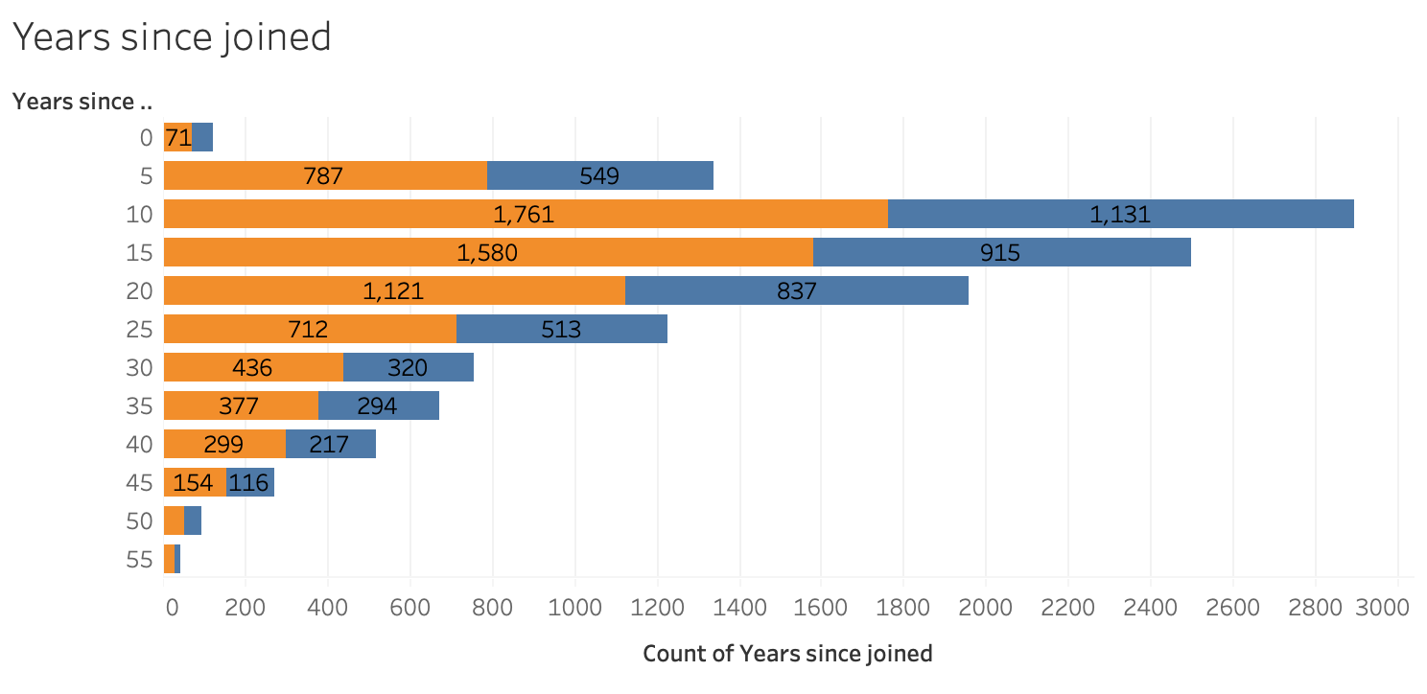
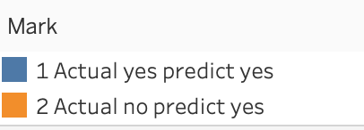
Business interpretation - Years since joined
Turn on years between 10-20 years
Targeted customers: turn on the electricity service around 2000 to 2010

Slide 39
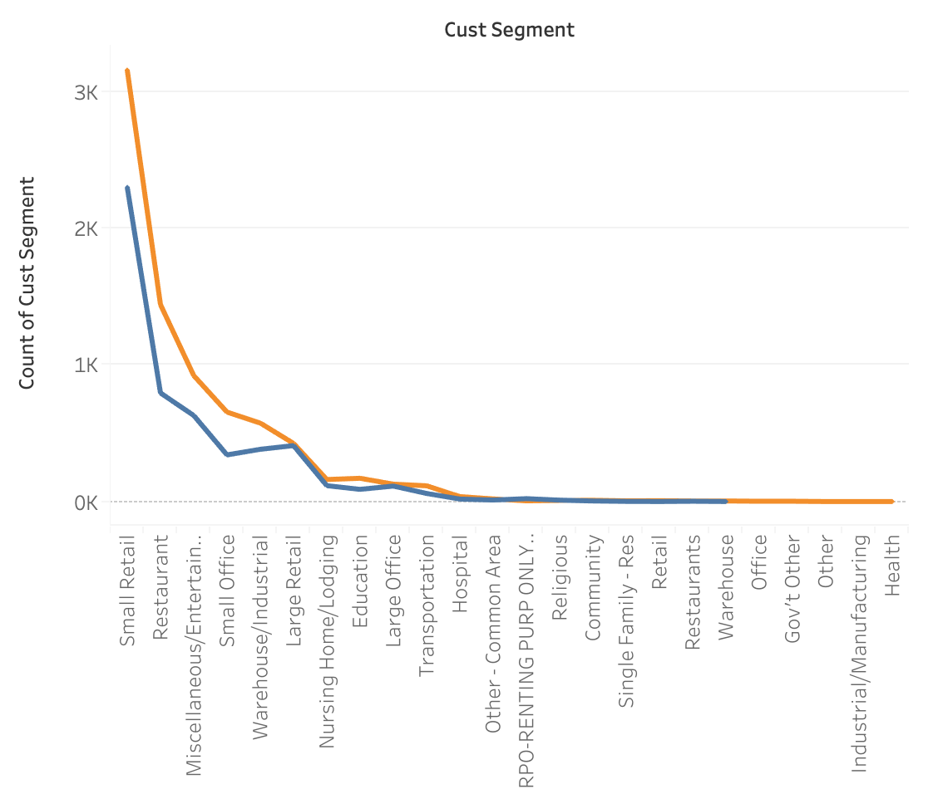
Business interpretation - Customer segment
Small/Large Retail
Restaurant
Entertainment
Small Office
Warehouse/Industrial

Slide 40
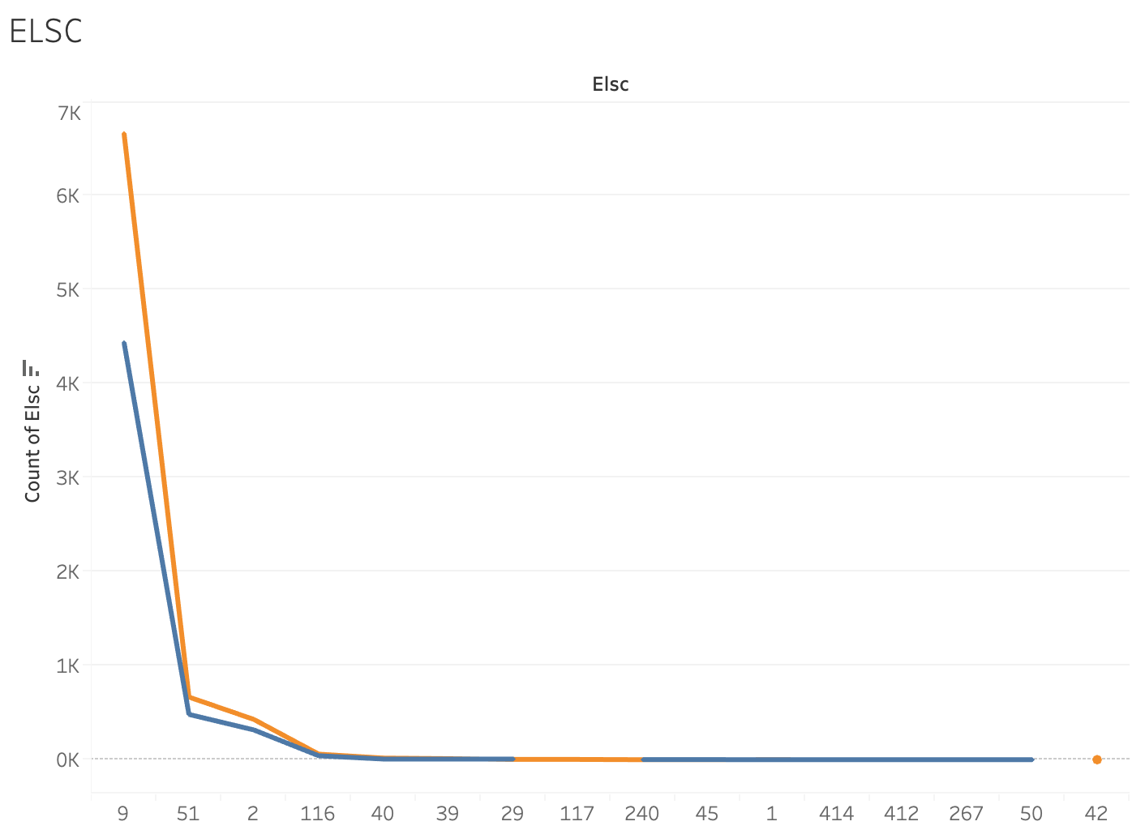
Business interpretation - ELSC
ELSC: categorical code of type of the account.
9 - General Large building
51 - Residential & Religious
2 - General Small Commercial

Slide 41
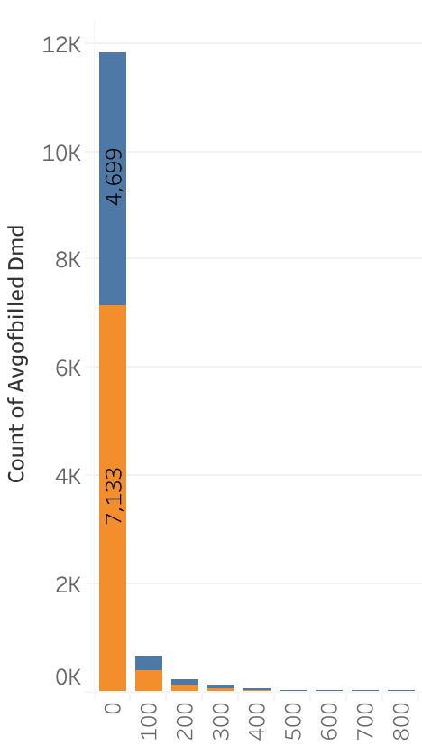
Business interpretation - Billed demand
Monthly average billed demand < 100 kW

Slide 42
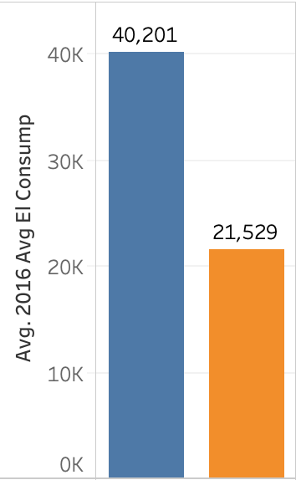
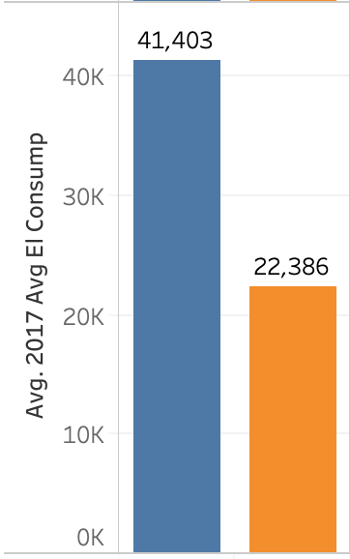
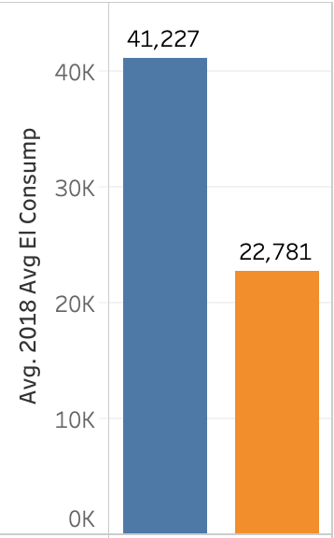
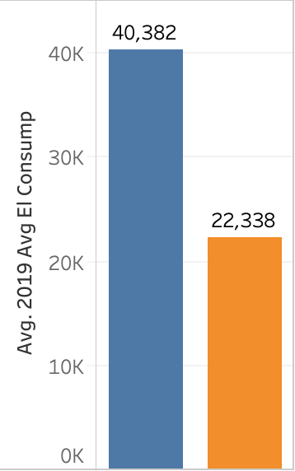
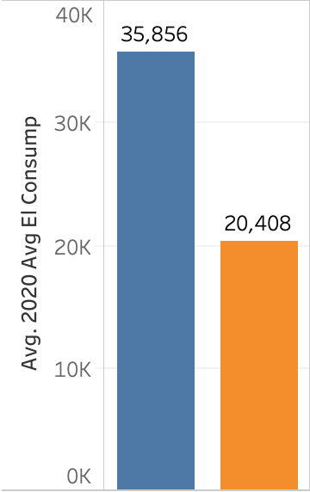
Business interpretation - Billed amount
Average yearly billed amount around $22,000 dollars.

Slide 43
05
BUSINESS STRATEGY

Slide 44
Recommendation
Model Selection
Gradient Boosting Model
Location
Brooklyn >Queens> Downtown Manhattan > Westchester
Customer Segment
Large/Small Commercial Retails, Restaurants, Warehouses, Residential house
Customers turn on date around 2000 - 2010
Electricity Demand & Billed amount
Average monthly electricity usage < 100 kW
Annual billed amount around $22,000

Slide 45
06
CONCLUSION

Slide 46
Conclusion
Objective
“Construct machine learning models to find out key characteristics to detect potential customers who need to join the EE program.”
Challenges
Large datasets, Imbalanced data
Model Recommendation
Gradient Boosting Model
Success Criteria
Recall/Precision, F1 Score, ROC AUC
Business Decisions
Locations, customer segments, electricity demand, billed amount
Notes:
First i want to restate the objective of our project, the issue that we aim to resolve in our problem statement.
We met several challenges, including the massive sizes in datasets, & imbalanced info in two datatset.
We spent lots of effors on shrinking the data, merge the two datasets, tranfrom data types and create new variables through featuring engineering
After the data preparation, we have used 5 different models, after considaratin and comparation, we chose to use the gradient boosting model, which proved to be the most effective model.
F1 score for weighted avg above 0.80, and auc roc(area under the curve) , the greater the better, final auc value of the gradient boosting model was 0.84.
Based on the models we are able to make recommendations for the business deciison, which covers the aspects of locations.
Deal with imbalanced data
Data cleaning
Feature selection
Meaningful feature engineering
Different packages (H2O, sklearn, seaborn-for graph, pandas, numpy)
Tableau
Access “success criteria” - Recall/Precision, F1 Score, ROC AUC

Slide 47

Model Deployment
Recommendation
Leverage AWS to house building, training, testing, and deploying models altogether
Reason
Virtual machines have a bigger capacity for scaling the data
Easier to handle multiples steps at the same place simultaneously
Dash-Plotly
Visualize data periodically

Slide 48
Thank you!
Any questions?
Notes:
Thanks for Con Edison’s support throughout the project.
Thanks again for your time and listening.
We are now open to questions.

Slide 49
SUPPORTING MATERIAL

Slide 50

Model interpretation

Slide 51

Variable importance - GBM

